Slide 1
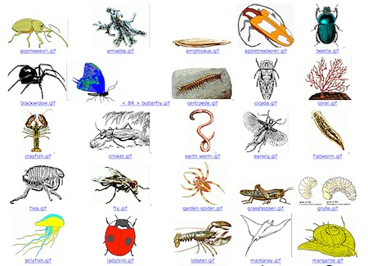
HHS 402G - Muscle Biology, 10/11/2017, Cooper

Slide 2
Types of Skeletal Systems
uca.edu/steminstitute/files/2011/07/TheMuscularSystem.pptx
Changes in movement occur because muscles pull against a support structure, called the skeletal system
-Zoologists recognize three types:
-Hydrostatic skeletons
-Exoskeletons
-Endoskeletons

Slide 3
Hydrostatic Skeletons
uca.edu/steminstitute/files/2011/07/TheMuscularSystem.pptx
Are found primarily in soft-bodied invertebrates, both terrestrial and aquatic
Locomotion in earthworms
-Involves a fluid-filled central cavity and surrounding circular & longitudinal muscles
-A wave of circular followed by longitudinal muscle contractions move fluid down body
-Produces forward movement

Slide 4
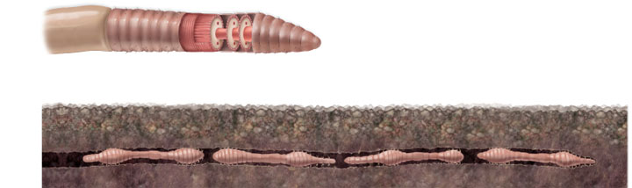
uca.edu/steminstitute/files/2011/07/TheMuscularSystem.pptx
Hydrostatic Skeletons
Copyright © The McGraw-Hill Companies, Inc. Permission required for reproduction or display.
Longitudinal muscles
Anterior
Longitudinal muscles
contract, and segments
catch up
Circular muscles
Longitudinal muscles contracted
Circular muscles
contracted
Circular muscles
contract, and anterior
end moves forward
Circular muscles
contract, and anterior
end moves forward

Slide 5
Hydrostatic Skeletons
uca.edu/steminstitute/files/2011/07/TheMuscularSystem.pptx
Locomotion in aquatic invertebrates
-Occurs by fluid ejections or jetting
-Jellyfish produce regular pulsations in bell
-Squeezing some of water contained beneath it
-Squids fill mantle cavity with sea water
-Muscular contractions expel water forcefully through the siphon, and the animal shoots backward

Slide 6
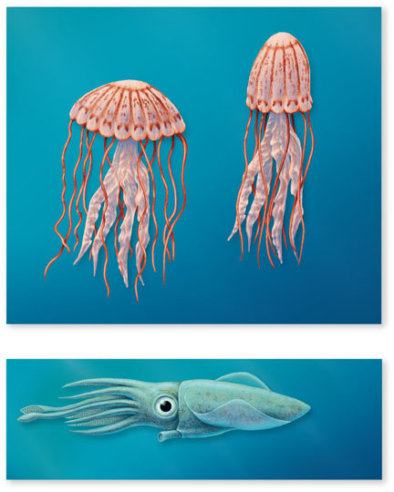
Copyright © The McGraw-Hill Companies, Inc. Permission required for reproduction or display.
uca.edu/steminstitute/files/2011/07/TheMuscularSystem.pptx
Jellyfish
propelled
upward
Bell
Contractile fibers
Bell
pulsates
Water
expelled
from bell
Water
enters
bell
a.
Squid
propelled
backward
Water expelled
from siphon
b.

Slide 7
Exoskeletons
uca.edu/steminstitute/files/2011/07/TheMuscularSystem.pptx
The exoskeleton surrounds the body as a rigid hard case
-Composed of chitin in arthropods
An exoskeleton provides protection for internal organs and a site for muscle attachment
-However, it must be periodically shed, in order for the animal to grow
-It also limits body size

Slide 8
Endoskeletons
uca.edu/steminstitute/files/2011/07/TheMuscularSystem.pptx
Endoskeletons are rigid internal skeletons that form the body’s framework and offer surfaces for muscle attachment
-Echinoderms have calcite skeletons, that are made of calcium carbonate
-Bone, on the other hand, is made of calcium phosphate

Slide 9
Endoskeletons
uca.edu/steminstitute/files/2011/07/TheMuscularSystem.pptx
Vertebrate endoskeletons have bone and/or cartilage
-Bone is much stronger than cartilage, and much less flexible
Unlike chitin, bone and cartilage are living tissues
-They can change and remodel in response to injury or physical stress

Slide 10
Modes of Animal Locomotion
novellaqalive.mheducation.com/sites/dl/free/9834092339/415942/chapt47_lecture.ppt
Locomotion in large animals involves:
-Appendicular locomotion
-Produced by appendages that oscillate
-Axial locomotion
-Produced by bodies that undulate, pulse or undergo peristaltic waves
The physical constraints to movement – gravity and frictional drag – occur in every environment, differing only in degree

Slide 11
Locomotion in Water
novellaqalive.mheducation.com/sites/dl/free/9834092339/415942/chapt47_lecture.ppt
Water’s buoyancy reduces effect of gravity
Some marine invertebrates move about using hydraulic propulsion
All aquatic invertebrates swim
-Swimming involves using the body or its appendages to push against the water
-An eel uses its whole body
-A trout uses only its posterior half

Slide 12
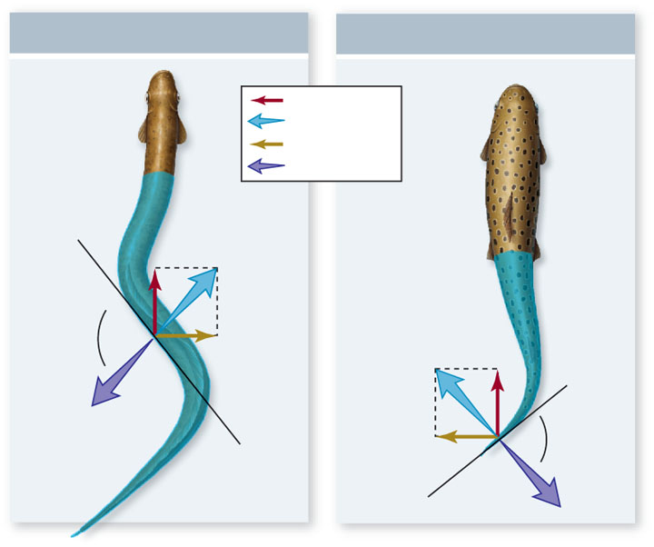
Copyright © The McGraw-Hill Companies, Inc. Permission required for reproduction or display.
novellaqalive.mheducation.com/sites/dl/free/9834092339/415942/chapt47_lecture.ppt
Eel
Trout
thrust
reactive force
lateral force
push
90º
90º
a.
b.

Slide 13
Locomotion in Water
novellaqalive.mheducation.com/sites/dl/free/9834092339/415942/chapt47_lecture.ppt
Many terrestrial tetrapod vertebrates are able to swim, usually through limb movement
-Most birds that swim propel themselves by pushing against water with their hind legs
-These typically have webbed feet
-Animals that swim with their forelegs usually have these modified as flippers and pull themselves through the water
-Sea turtles and penguins

Slide 14
Locomotion on Land
novellaqalive.mheducation.com/sites/dl/free/9834092339/415942/chapt47_lecture.ppt
Terrestrial locomotion deals mainly with gravity
Mollusks glide along a path of mucus
Vertebrates and arthropods have a raised body, and move forward by pushing against the ground with jointed appendages – legs
-Vertebrates are tetrapods; all arthropods have at least six limbs
-Having extra legs increases stability, but reduces the maximum speed

Slide 15
Locomotion on Land
novellaqalive.mheducation.com/sites/dl/free/9834092339/415942/chapt47_lecture.ppt
The basic walking pattern of quadrupeds generates a diagonal pattern of foot falls
-Left hind leg, right foreleg, right hind leg, left foreleg
-Allows running by a series of leaps
Some vertebrates are also effective leapers
-Kangaroos, rabbits and frogs have powerful leg muscles

Slide 16
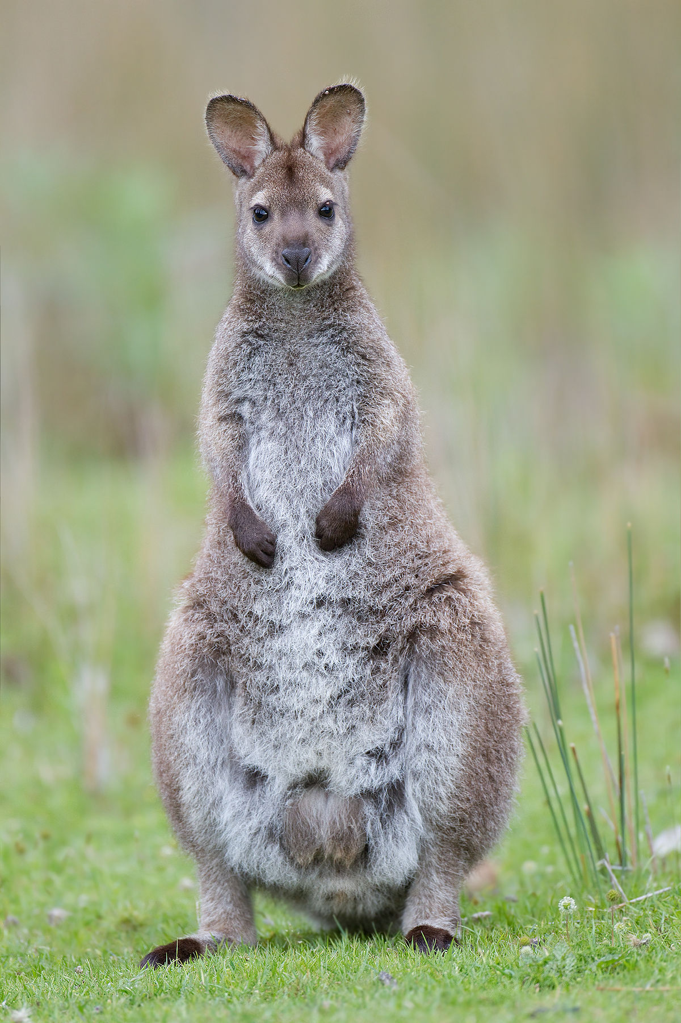
Red-necked wallaby

Slide 17
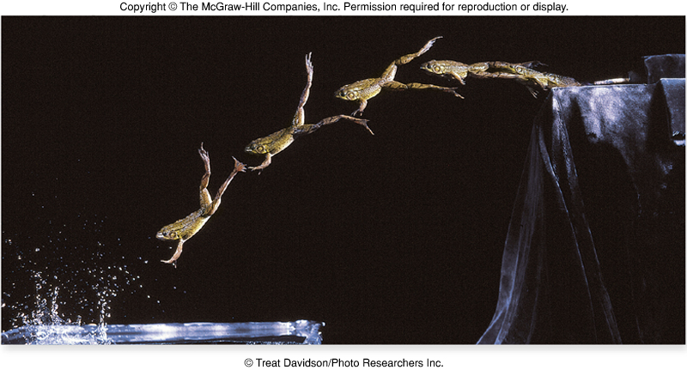
Locomotion on Land
novellaqalive.mheducation.com/sites/dl/free/9834092339/415942/chapt47_lecture.ppt

Slide 18
Locomotion in Air
novellaqalive.mheducation.com/sites/dl/free/9834092339/415942/chapt47_lecture.ppt
Flight has evolved among animals four times
-Insects, pterosaurs (extinct flying reptiles), birds, and bats
-Propulsion is achieved by pushing down against the air with wings
In birds and most insects, wing raising and lowering is achieved by alternate contraction of extensor muscles (elevators) and flexor muscles (depressors)

Slide 19
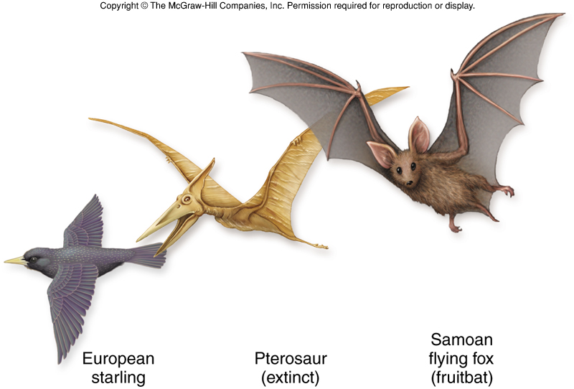
novellaqalive.mheducation.com/sites/dl/free/9834092339/415942/chapt47_lecture.ppt
Locomotion in Air
These different vertebrates all have lightened bones and forelimbs transformed into wings

Slide 20
ASYNCHRONOUS MUSCLE
Asynchronous muscle, the basalar flight muscle of the beetle Cotinus mutabilis
Synchronous wing muscles from the locust, Schistocerca americana.
Because of delayed stretch activation and shortening deactivation, a tetanically stimulated beetle muscle can do work when subjected to repetitive lengthening and shortening. The synchronous locust muscle, subjected to similar stimulation and length change, absorbs rather than produces work.
ROBERT K. JOSEPHSON, JEAN G. MALAMUD AND DARRELL R. STOKES
The Journal of Experimental Biology 203, 2713–2722 (2000)

Slide 21
Approximately three-quarters of the known insect species have asynchronous flight muscles (Dudley, 1991).
Asynchronous muscles are high-frequency muscles. The wing-stroke frequency during flight of insects using asynchronous muscle ranges from approximately 20 Hz in large belostomatid bugs (Barber and Pringle, 1966) to 500–1000 Hz in small midges (Sotavalta, 1947, 1953).
But high-frequency muscles need not be asynchronous. Among high-frequency, synchronous muscles are the shaker muscle of the rattlesnake rattle (up to 90 Hz; Schaeffer et al., 1996; Rome and Lindstedt, 1998), the toadfish soundproducing muscle (over 200 Hz; Fine, 1978; Fine and Mosca, 1989; Rome et al., 1996), the muscles used in stridulation by the katydid Neoconocephalus robustus (200 Hz; Josephson and Halverson, 1971) and the tymbal muscle used in sound production by the cicada Okanagana vanduzeei (550 Hz; Josephson and Young, 1985).
In synchronous muscles, the myofibrils are enveloped by a layer of sarcoplasmic reticulum; in asynchronous muscles, the sarcoplasmic reticulum is sparse and scattered. Muscle activation in both synchronous and asynchronous muscle results from the release of Ca2+ from the sarcoplasmic reticulum in response to fiber depolarization; relaxation follows re-uptake of the released Ca2+ by the sarcoplasmic reticulum. High-frequency operation requires brief contractions. The short twitch duration in synchronous muscle is achieved in part by hypertrophy of the sarcoplasmic reticulum and by a reduction in the diameter of the contractile myofibrils (Josephson and Young, 1987).
Think mitochondria within the fibers. Energy demand.

Slide 22
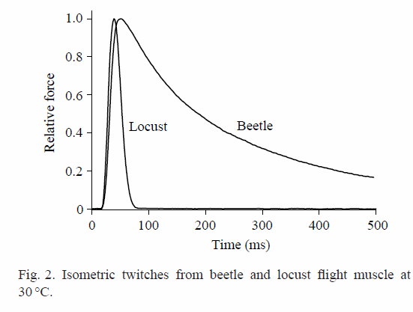

Slide 23
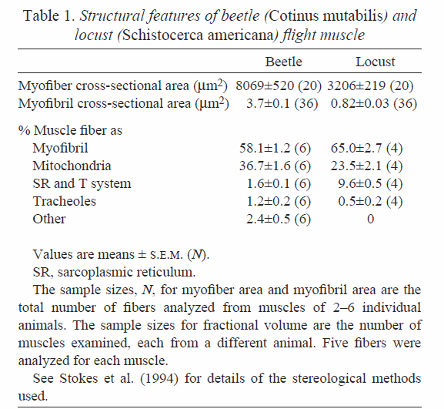

Slide 24
The maximum active stress during tetanic stimulation in a set of beetle muscles averaged 32.6±13.2kNm⁻² (mean ± S.D., N=19,at 35 °C).
In contrast, the active stress in locust flight muscle
was found to be approximately 360kNm⁻²
Values reported for maximum tetanic stress in most synchronous muscles range from 100 to 400kNm⁻²

Slide 25
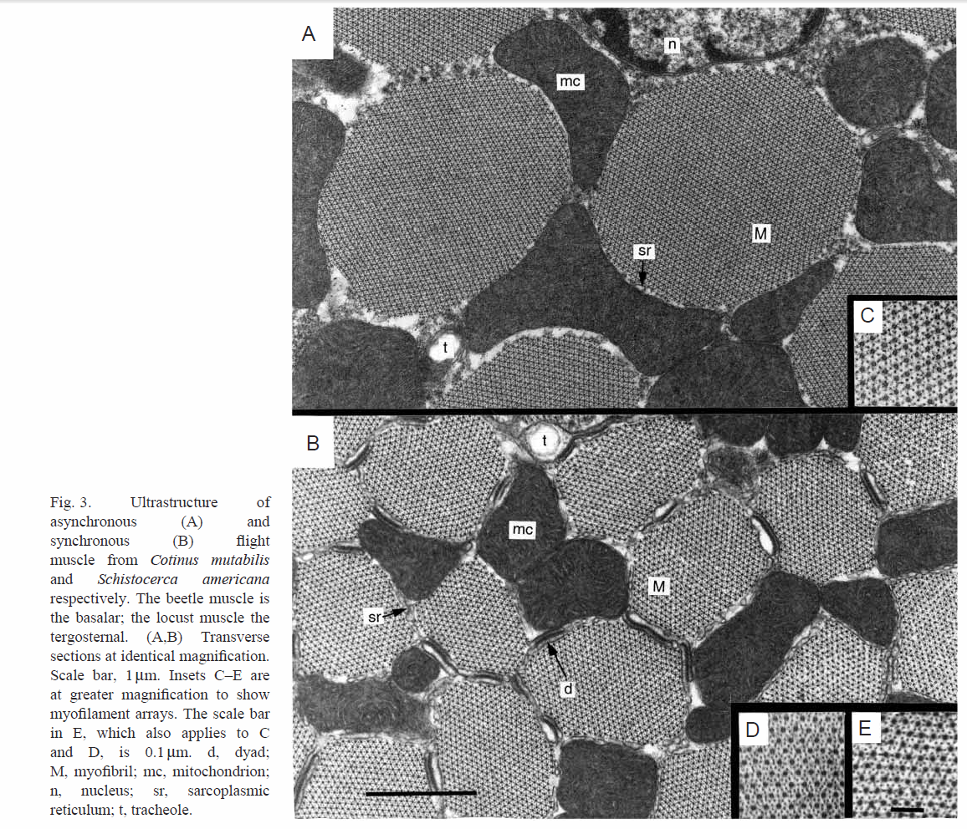

Slide 26
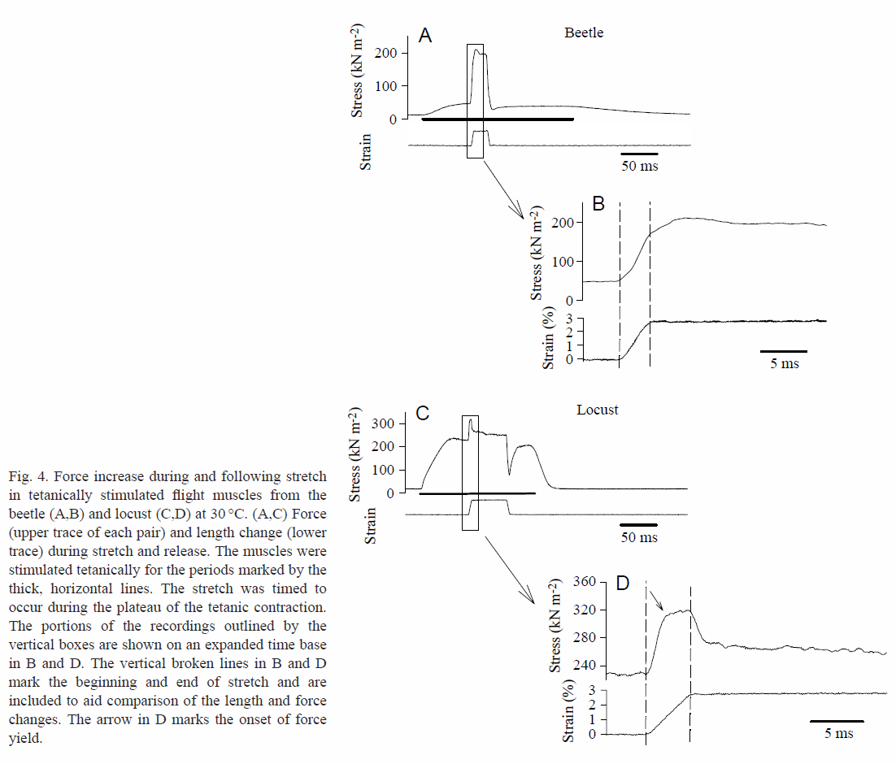
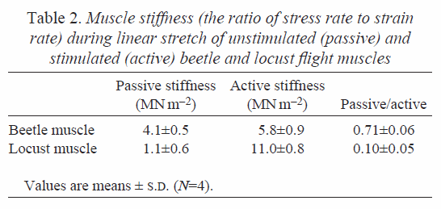

Slide 27
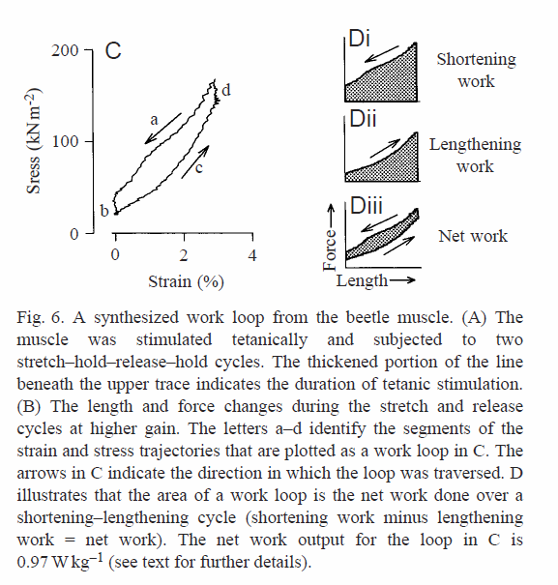
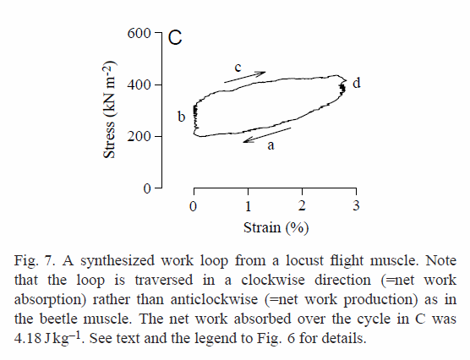

Slide 28
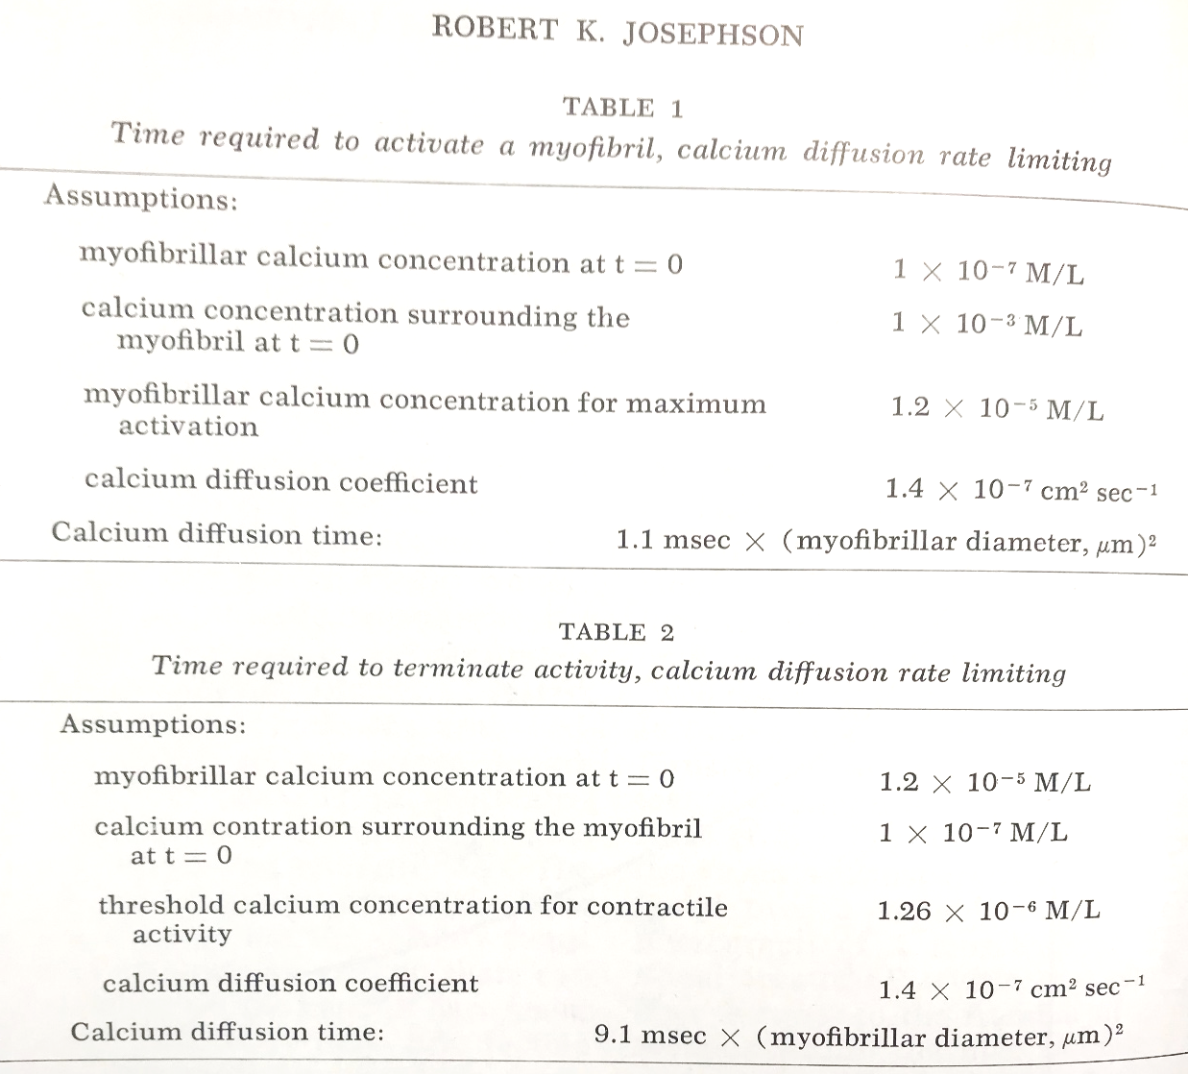

Slide 29
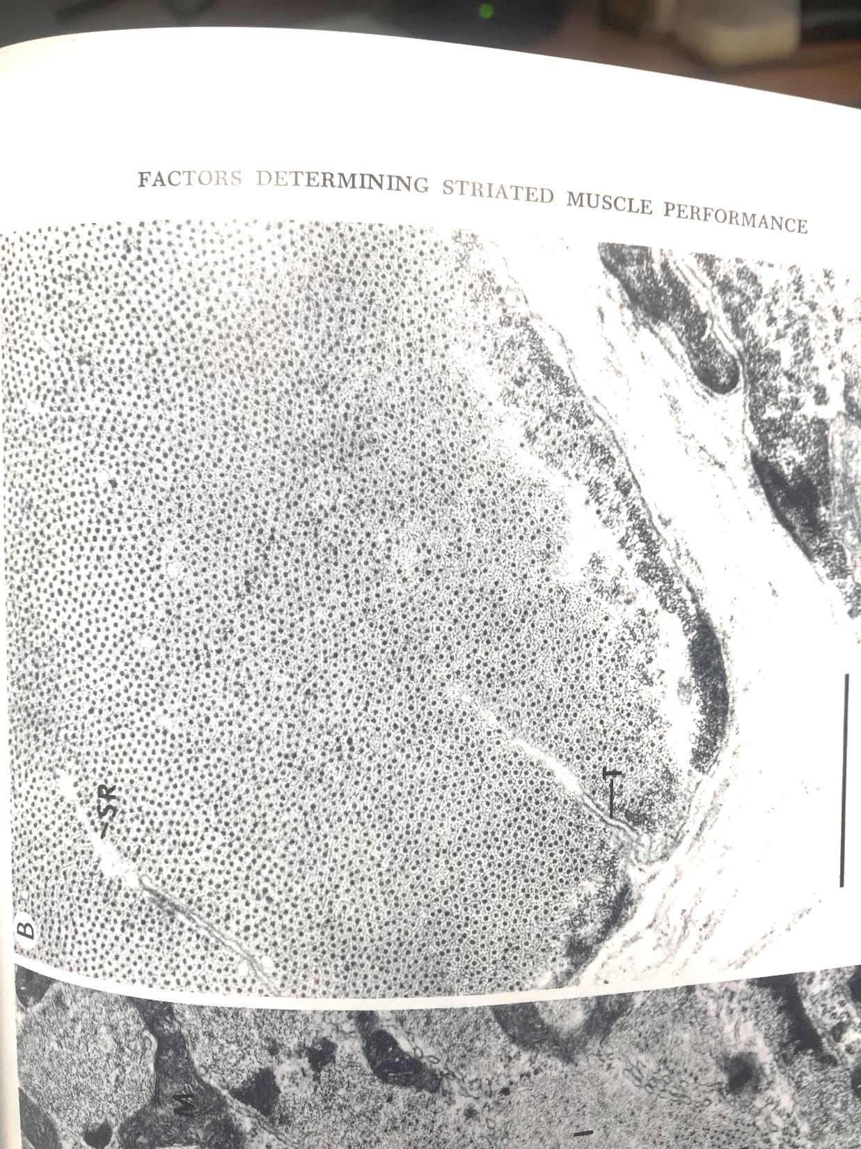
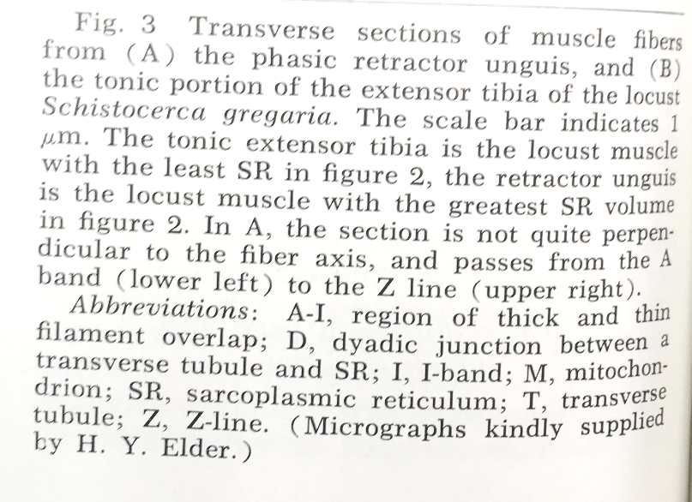

Slide 30
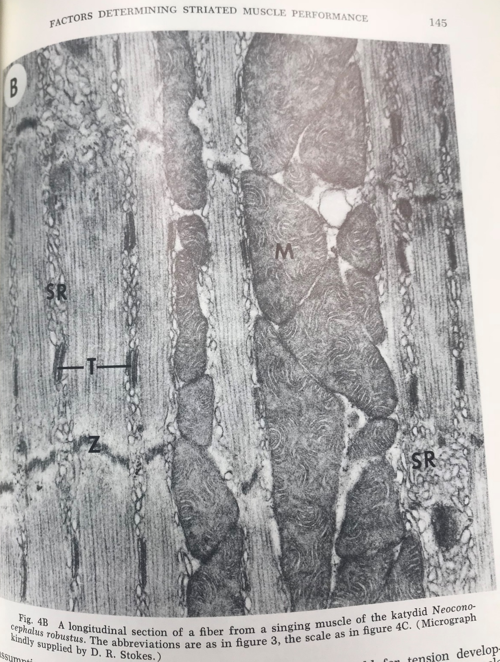

Slide 31
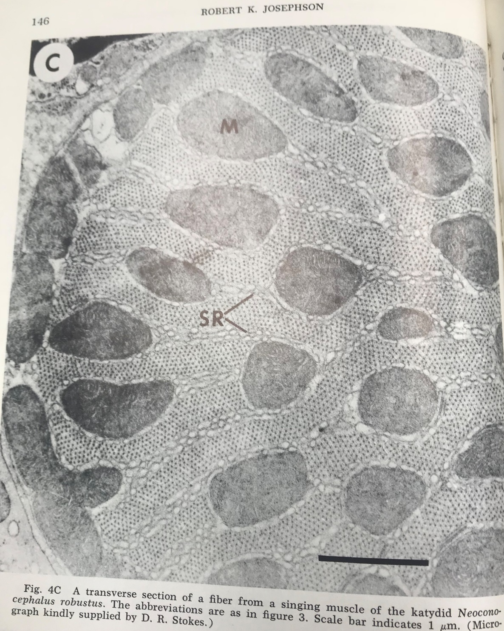

Slide 32
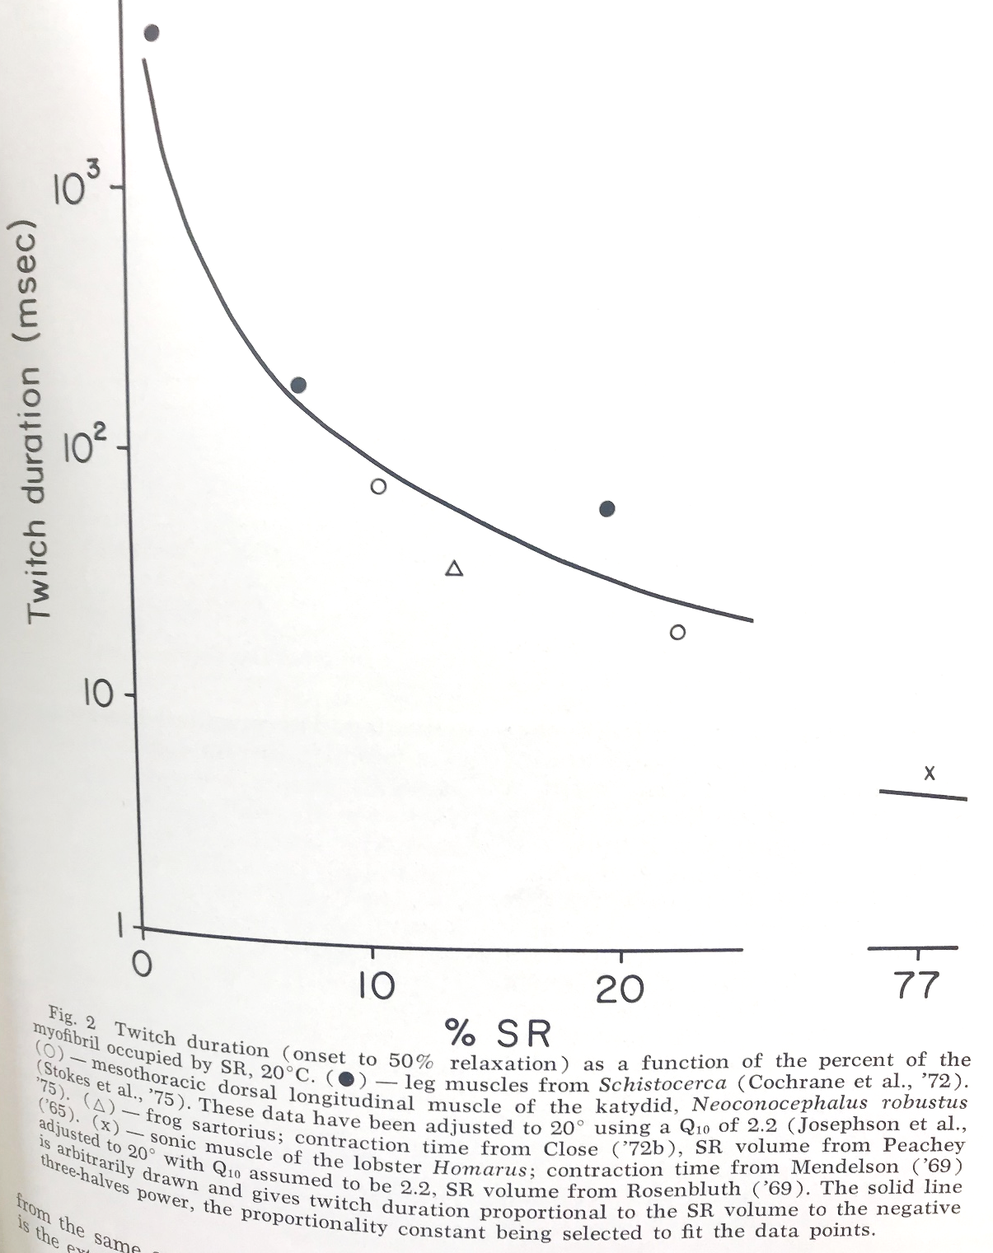

Slide 33
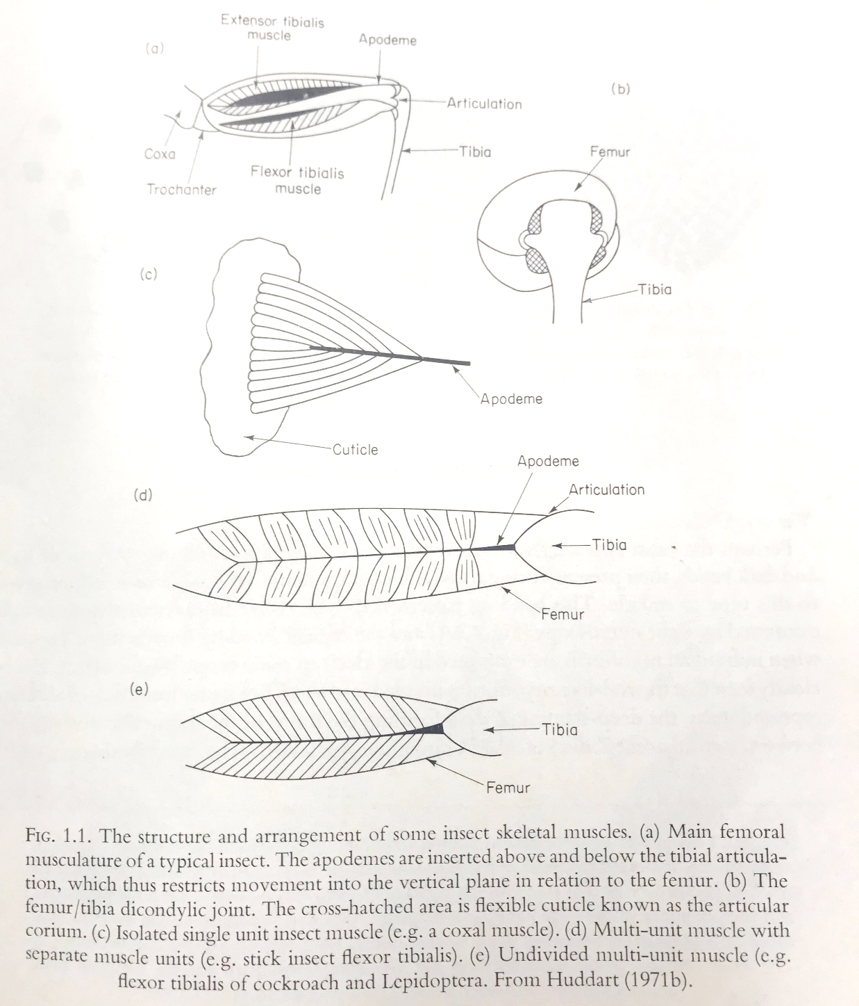

Slide 34
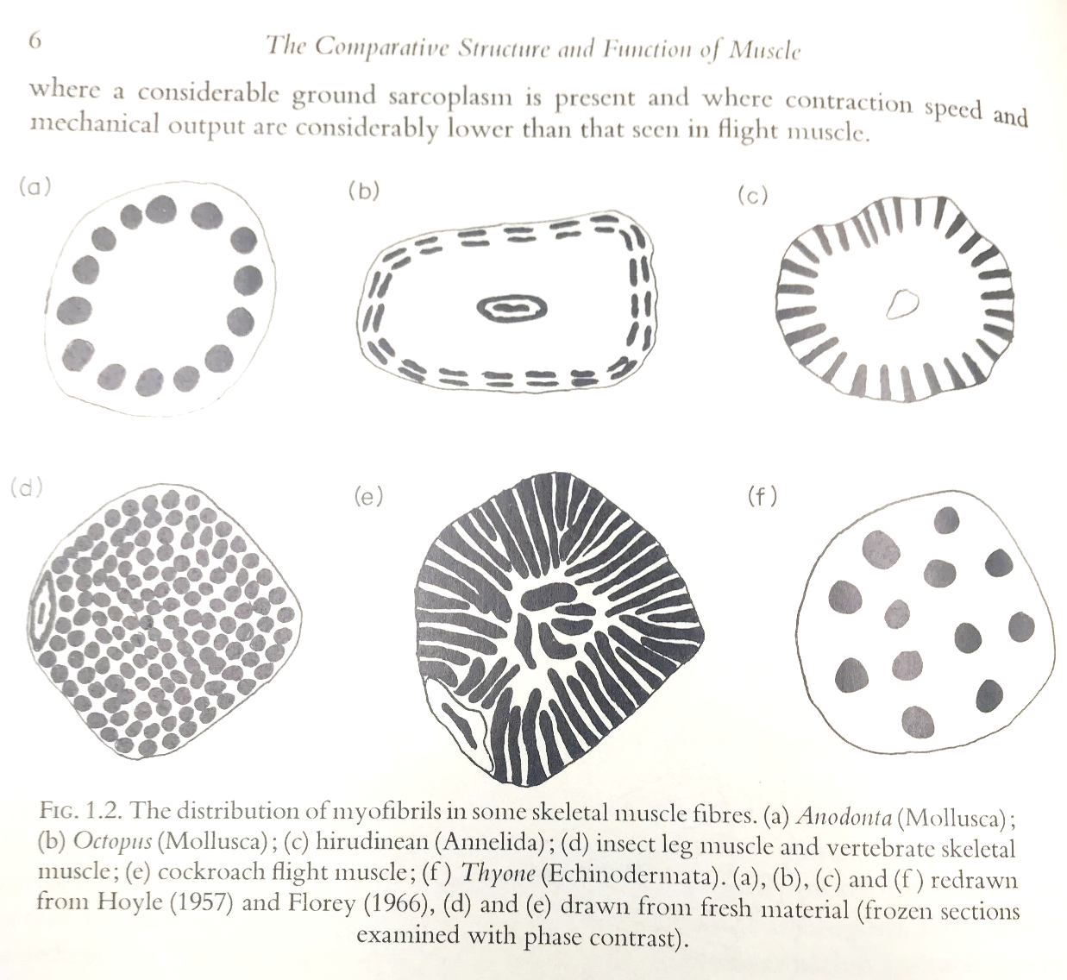

Slide 35
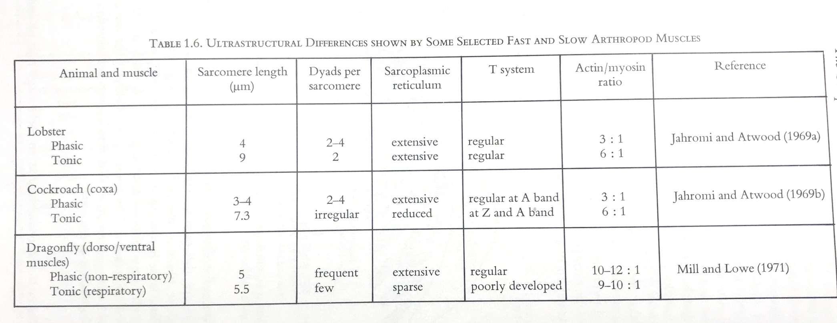
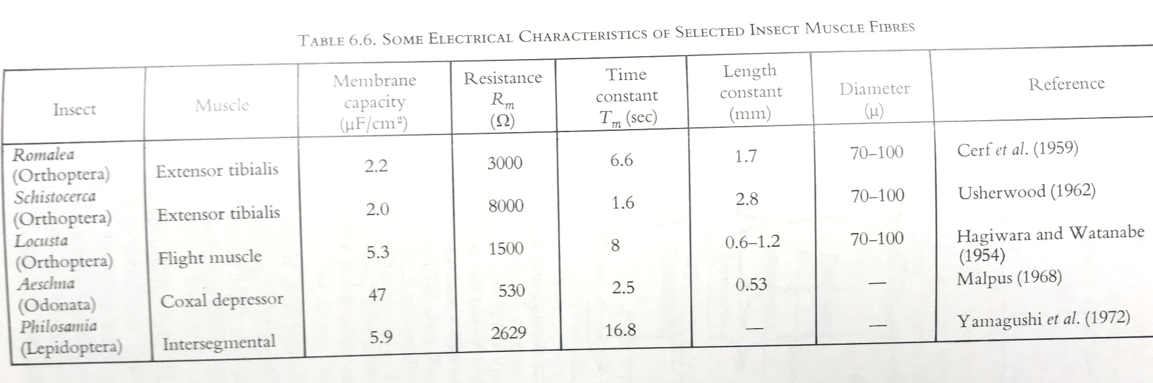

Slide 36
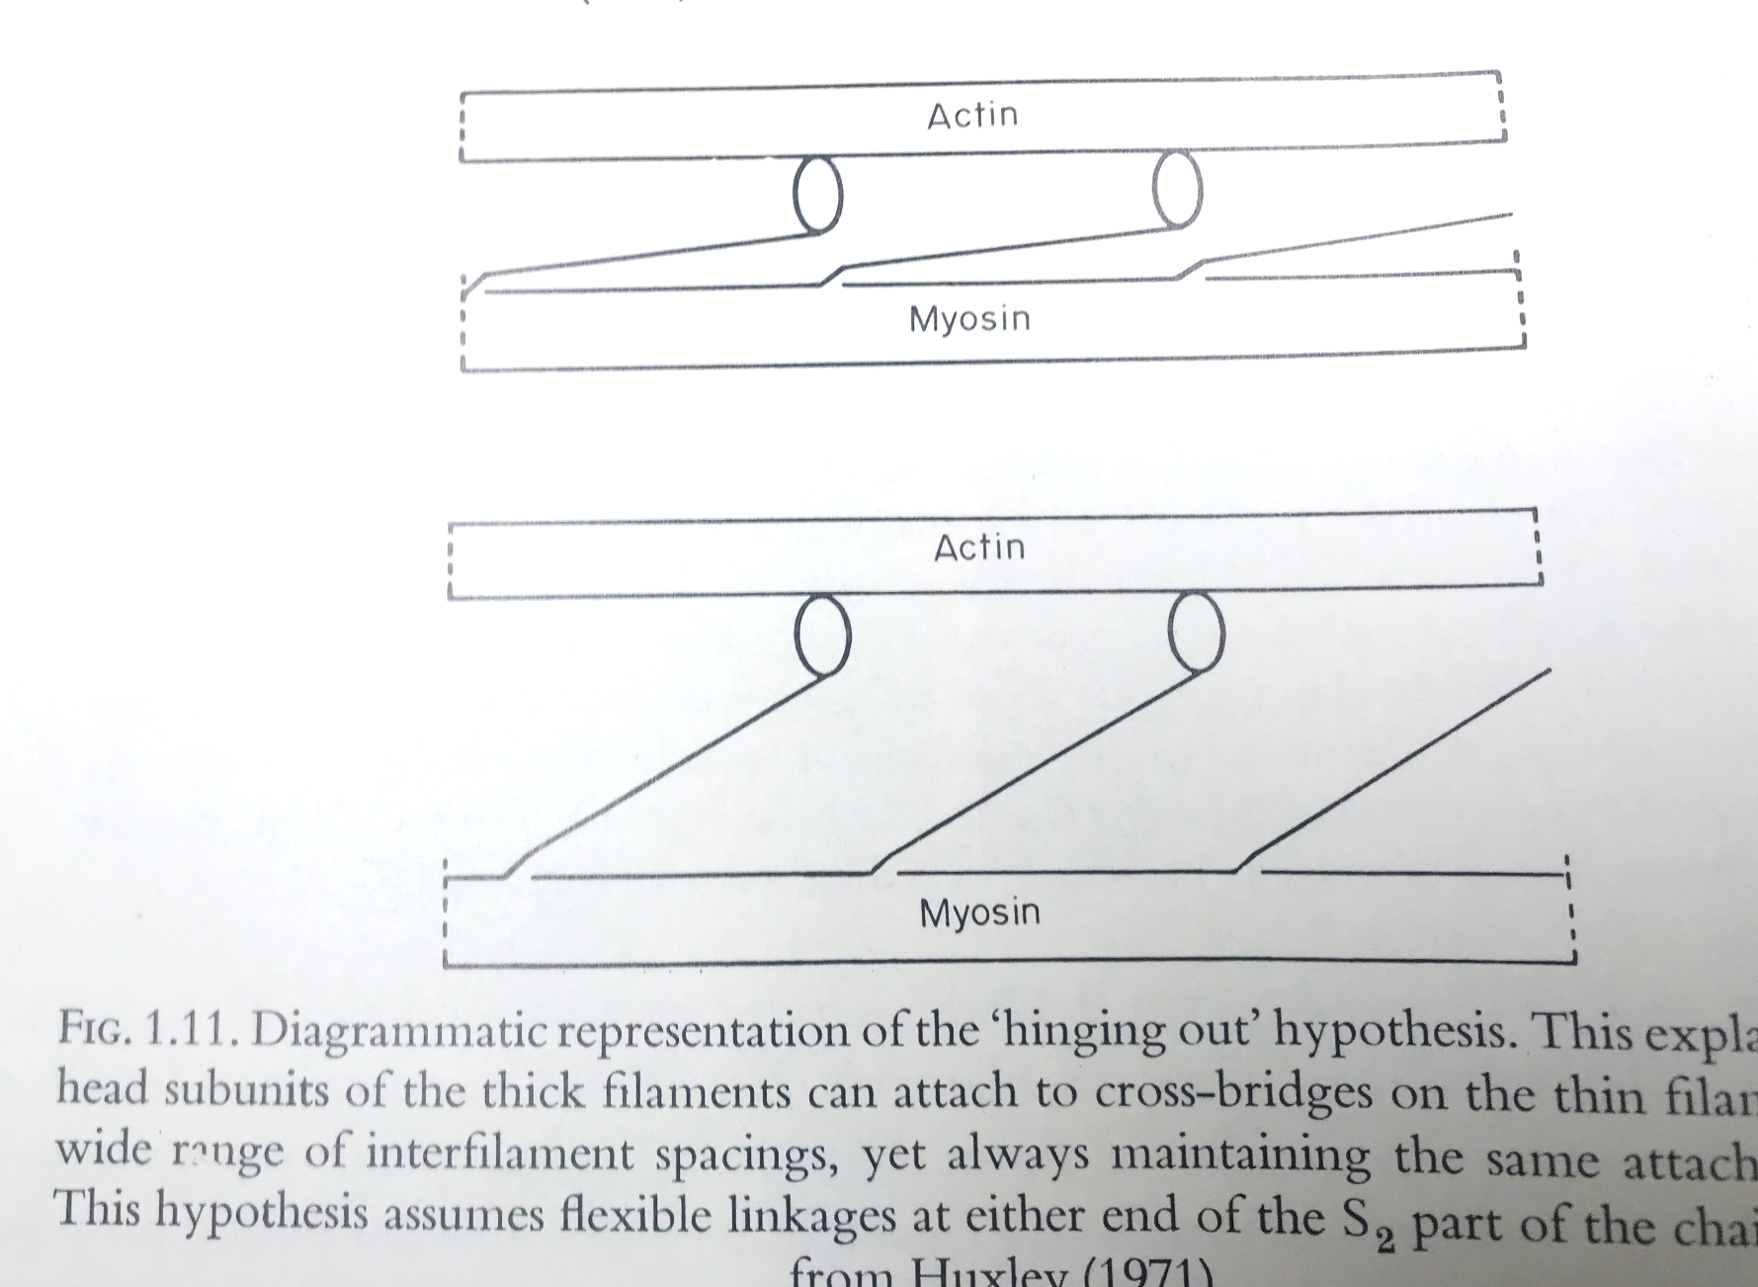

Slide 37
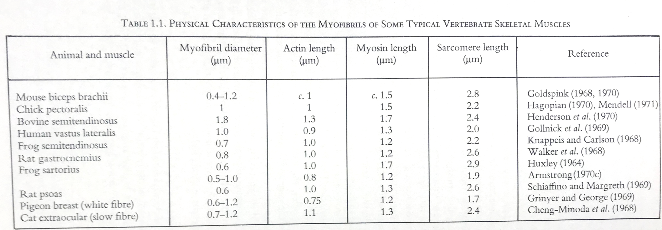
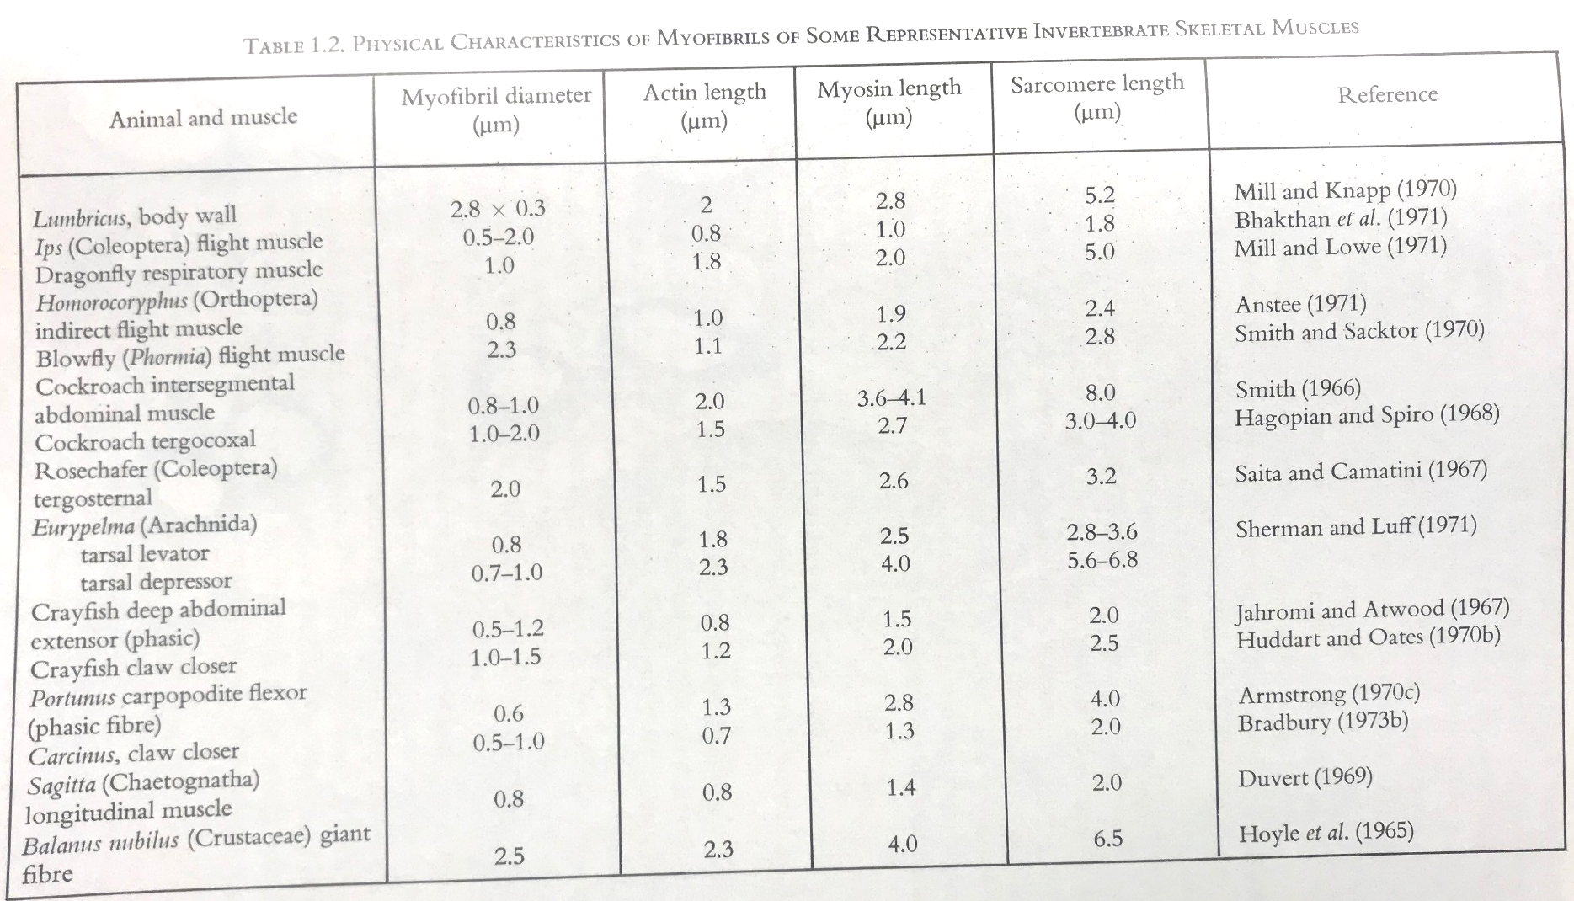

Slide 38
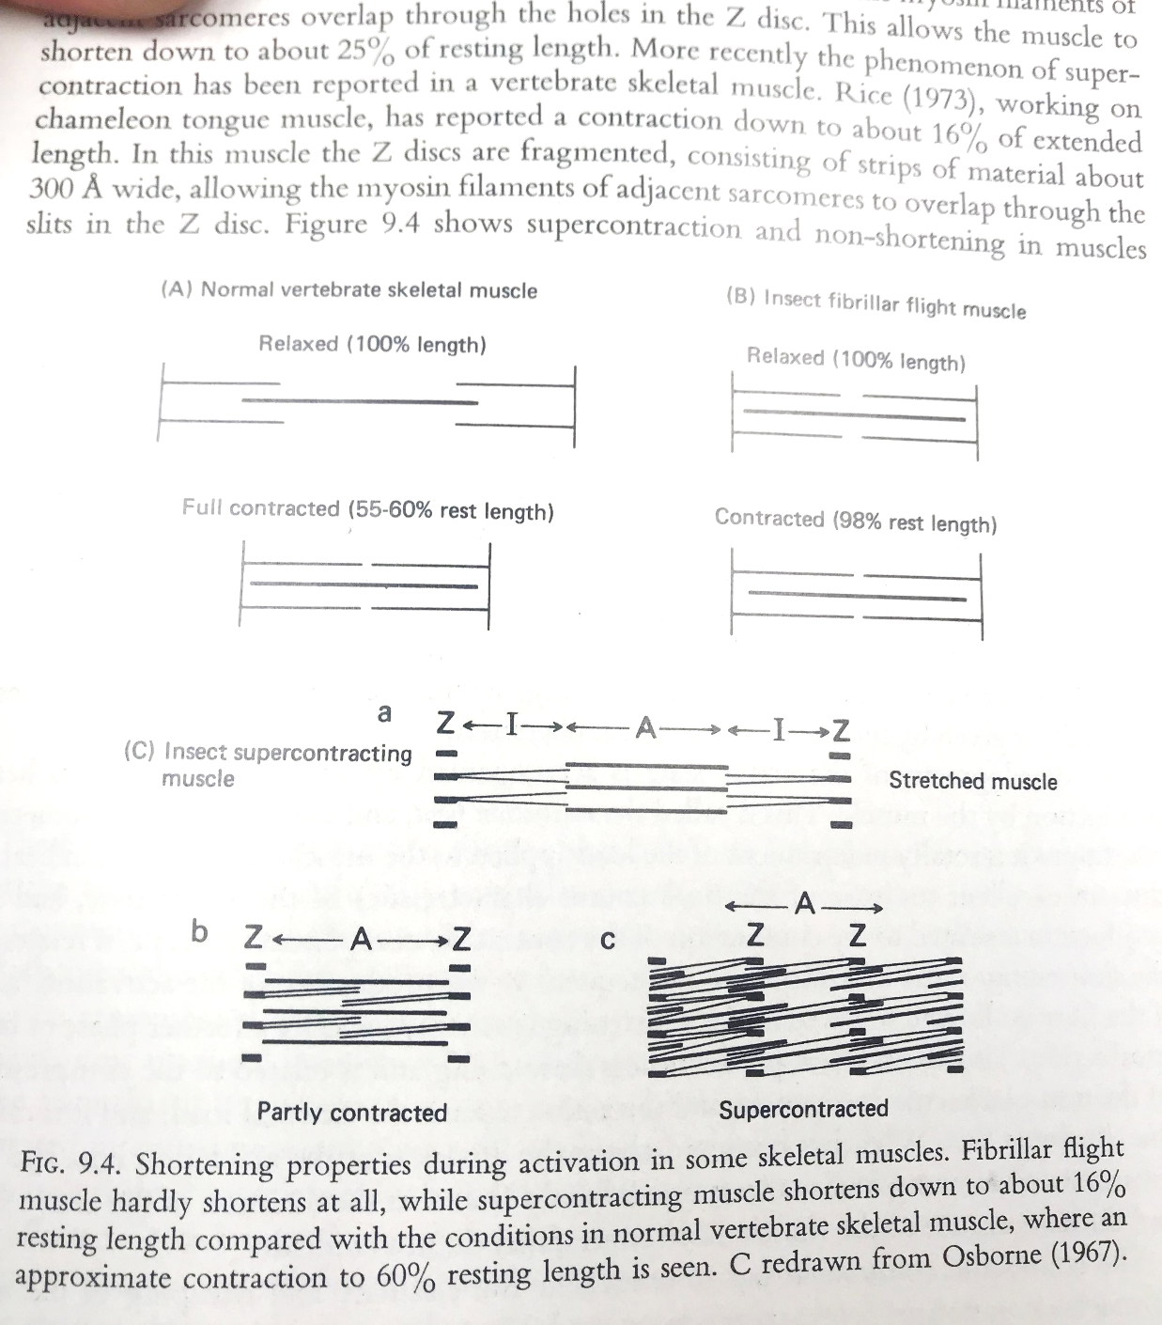

Slide 39
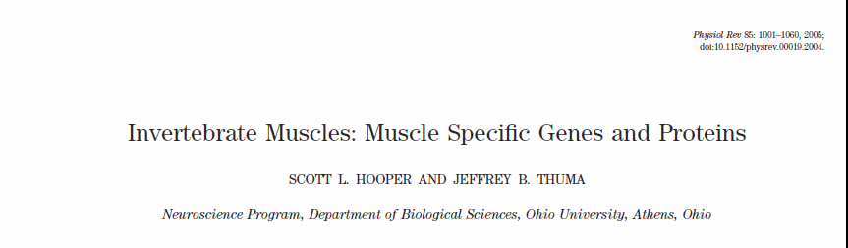

Slide 40
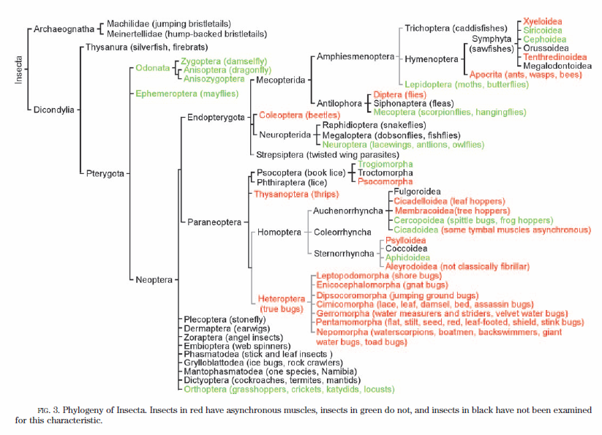

Slide 41
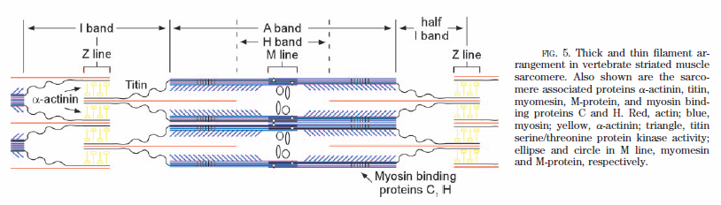

Slide 42
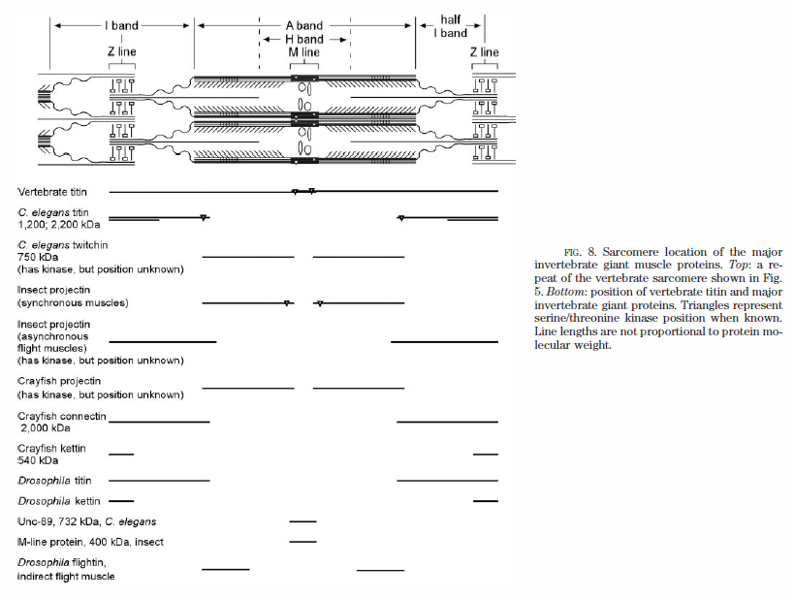

Slide 43
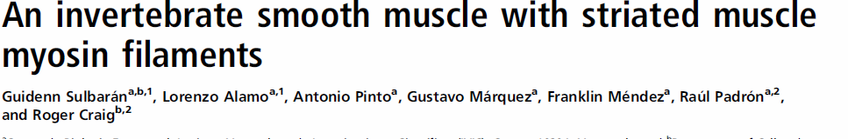
Here we have studied the structure of myosin filaments from the smooth muscles of the human parasite Schistosoma mansoni. We find, surprisingly, that they are indistinguishable from those in an arthropod striated muscle

Slide 44
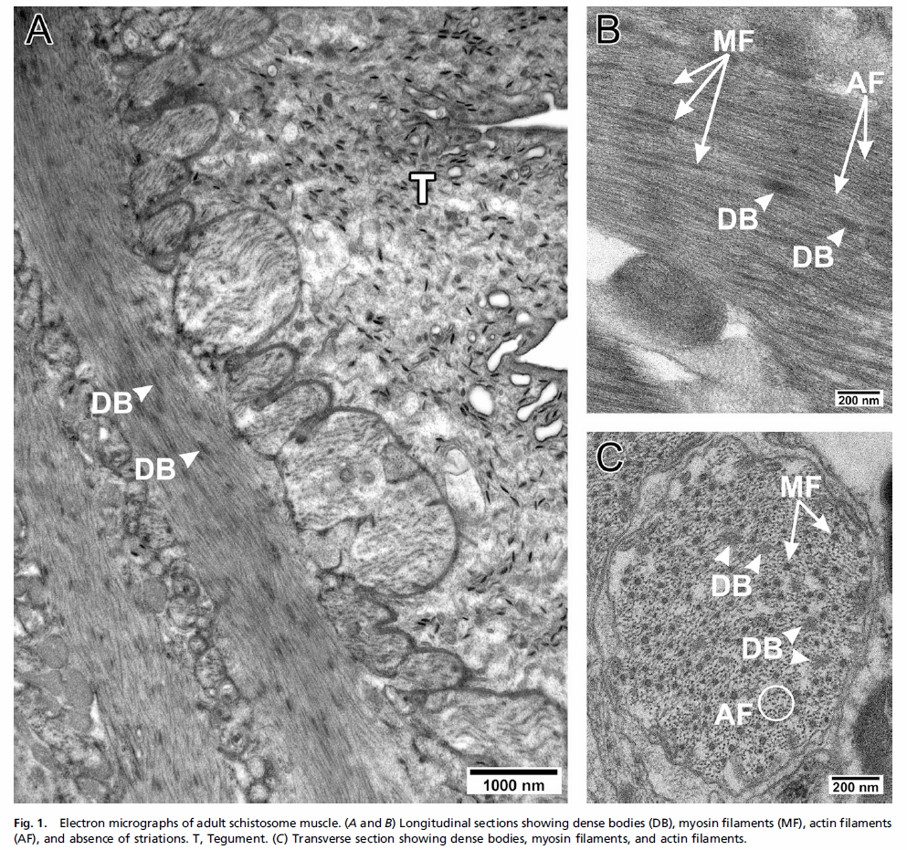

Slide 45
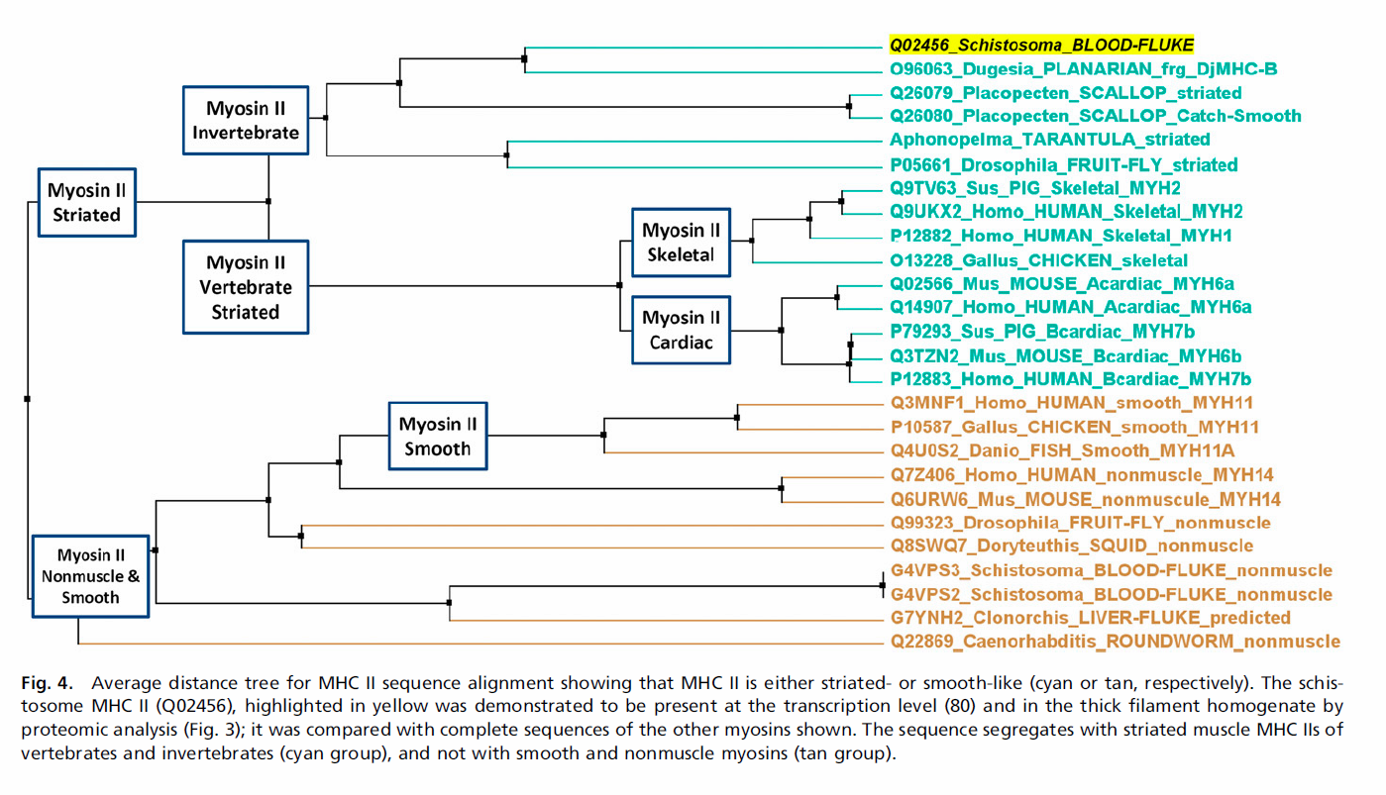

Slide 46
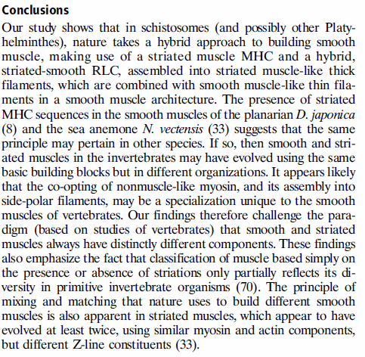

Slide 47
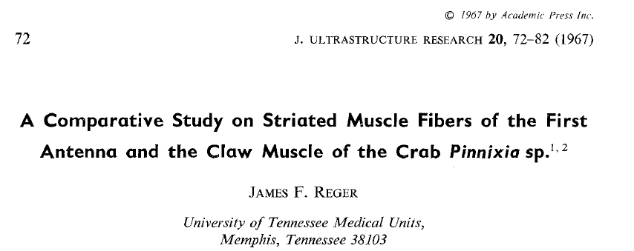

Slide 48
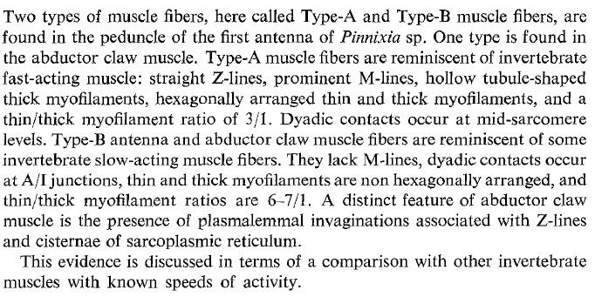

Slide 49
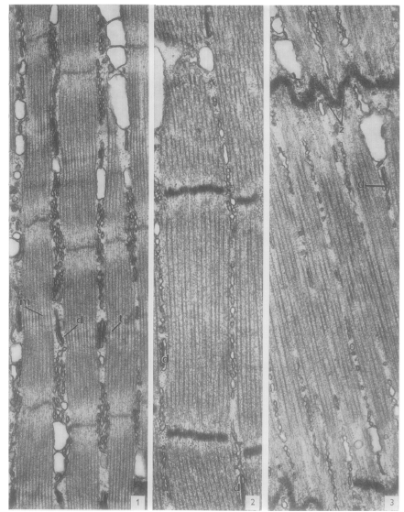
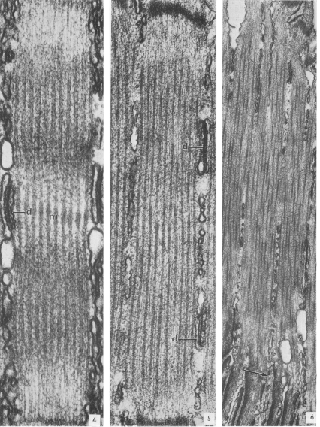
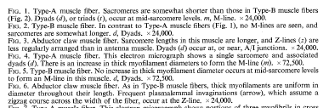

Slide 50
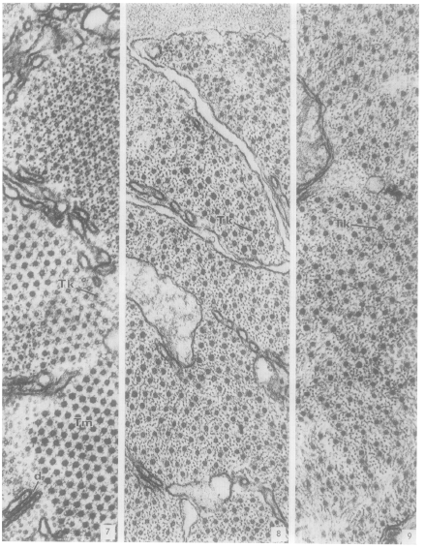
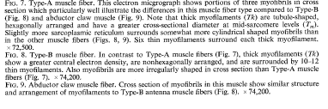

Slide 51


Slide 52
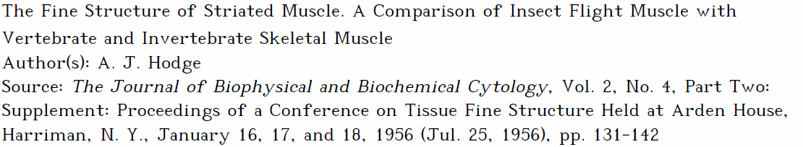
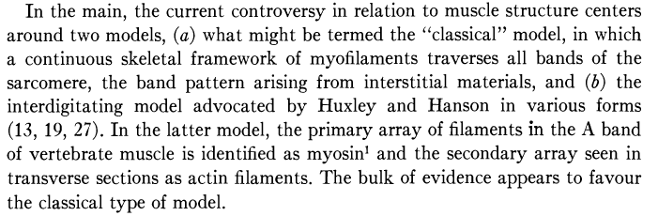

Slide 53
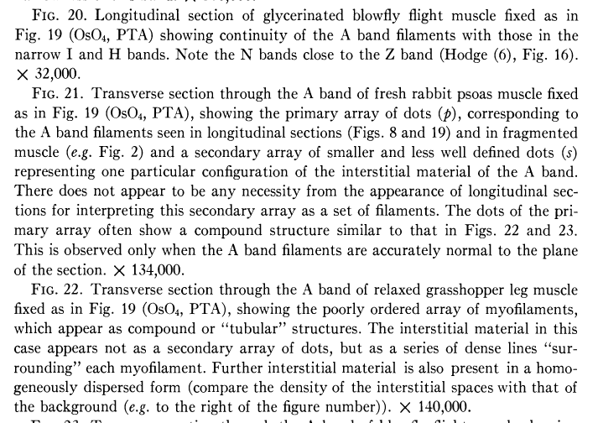

Slide 54
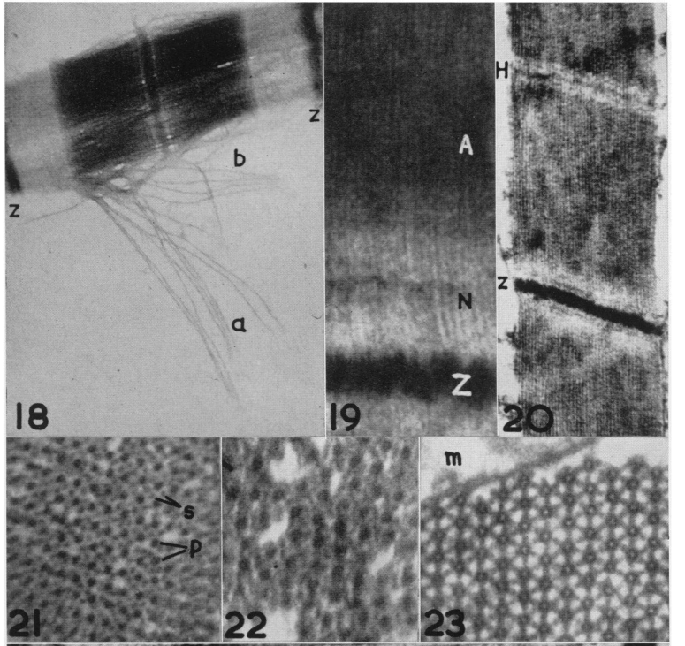

Slide 55
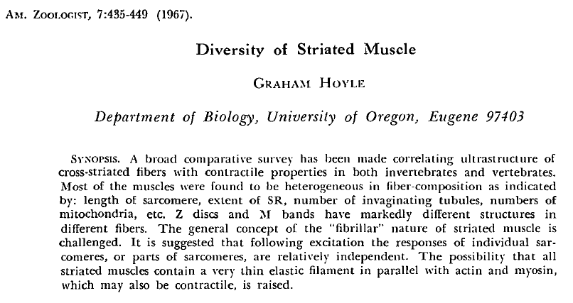

Slide 56
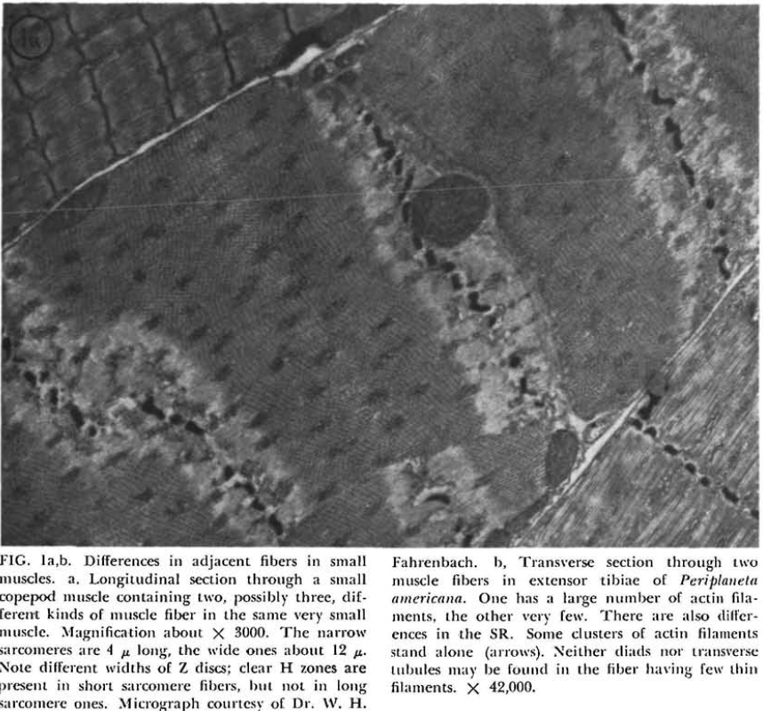

Slide 57
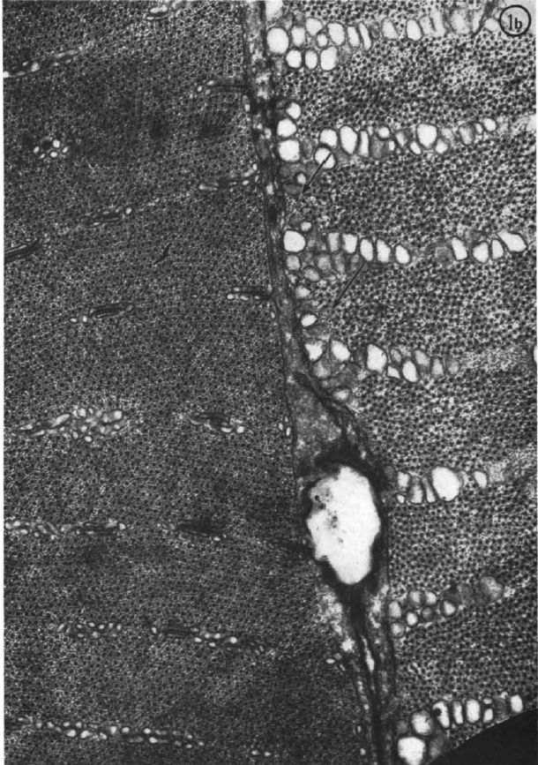


Slide 58



Slide 59



Slide 60


Slide 61


Slide 62


A: maximum shortening velocity (Vmax) as a function of body mass.
Scott Medler Am J Physiol Regul Integr Comp Physiol 2002;283:R368-R378
©2002 by American Physiological Society
Notes:
A: maximum shortening velocity (V_{max}) as a function of body mass. All data are grouped together. There was a significant (P < 0.0001,r² = 0.34) relationship between V_{max} and body mass described by the equation: V_{max} = 10.8 · (mass)^{−0.17}.B: data for muscles used in terrestrial locomotion. There was a significant (P < 0.0001,r² = 0.61) relationship between V_{max} and body mass: V_{max} = 15.9 · (mass)^{−0.25}. C: data for muscles used in flight, with the data collected from birds in vivo fit with a separate regression equation (○). There was a significant (P < 0.024; r²= 0.60) scaling relationship between V_{max} and body mass for the bird flight muscles measured in vivo: V_{max} = 38.6 · (mass)^{−0.13}. The relationship for the rest of the fliers (●) was also significant (P < 0.0001, r² = 0.62) but had an elevation more than four times less than for the birds: V_{max} = 8.3 · (mass)^{−0.20}. The slopes of these two lines were not significantly different from one another (P > 0.63). D: data for muscles used in flight and terrestrial locomotion pooled. Analysis of covariance indicated that the regression lines from these 2 groups were not significantly different from one another. There was a significant (P < 0.0001, r² = 0.65) relationship between V_{max} and body mass for these data: V_{max} = 10.2 · (mass)^{−0.20}. There was no significant relationship between V_{max} and body mass in muscles used for swimming (E) nor for nonlocomotory muscles (F).

Slide 63

Po as a function of Vmax, mass, and taxonomic group.
Scott Medler Am J Physiol Regul Integr Comp Physiol 2002;283:R368-R378
©2002 by American Physiological Society
Notes:
P_{o} as a function of V_{max}, mass, and taxonomic group. A: P_{o} from locomotory muscles showed a significant (P < 0.032;r² = 0.07) increase as a function of V_{max}: P_{o} = 122 · V_{max}^{0.14}. B: P_{o} showed no relationship with body mass. C: P_{o} was significantly (P < 0.05) higher (*) in muscles from crustaceans, amphibians, and mollusks than in muscles from other taxonomic groups as indicated by a Kruskal-Wallis rank test (mean ± SE).

Slide 64




Slide 65


Slide 66




Slide 67


Slide 68


Slide 69


Slide 70
J Muscle Res Cell Motil. 2005;26(6-8):449-54.
Molecular and biochemical characterization of kettin in Caenorhabditis elegans.
Ono S¹, Mohri K, Ono K.
Author information
Abstract
Kettin is a unique member of the connectin/titin family of muscle elastic proteins, which has repetitive immunoglobulin-like domains that are separated by weakly conserved linker sequences. In striated muscles of insects and crayfish, kettin binds to actin filaments and localizes to the Z-disc and its adjacent region in the I-band. Recent sequence analysis of invertebrate connectin/titin (also known as SLS proteins) has revealed that kettin is a splice variant of connectin/titin. In contrast, in the nematode Caenorhabditis elegans, the kettin gene is independent of the genes for other connectin/titin-related proteins. Immunofluorescent localization of kettin shows that it localizes to the I-bands in the obliquely striated body wall muscle. Therefore, C. elegans is an attractive model system to study specific functions of kettin in muscle cells.

Slide 71

General differences in NMJ physiology of crustaceans

Slide 72


Slide 73


Slide 74


Slide 75


Slide 76


Slide 77


Slide 78

Crayfish

Slide 79



Slide 80


Slide 81
Leg extensor muscle
?
?

Slide 82


Slide 84



Slide 85


Slide 86


Christoph Körber and Thomas Kuner
Heidelberg, Germany, Front. Synaptic Neurosci., 2016

Slide 87

Christoph Körber and Thomas Kuner
Heidelberg, Germany, Front. Synaptic Neurosci., 2016

Slide 88

Leg opener
1 excitatory nerve

Slide 89

Mykles, D.L., Medler, S.A., Koenders, A., and Cooper, R.L. (2002) Myofibrillar protein isoform expression is correlated with synaptic efficacy in slow fibres of the claw and leg opener muscles of crayfish and lobster. Journal of Experimental Biology 205 (4): 513-522.

Slide 90

Leg extensor
Mixed innervation
High and low motor nerves on one muscle fiber

Slide 91



Slide 92


5% gel
4.8% gel increased protein loads

Slide 93


Slide 94


10 um
Conditioned
Notes:
10 um

Slide 95




- Decrease neural activity?,
decrease muscle load
- Space- Astronauts

Slide 96

GAL4-UAS system in Drosophila
GAL4 = transcriptional regulator/ enhancer
(yeast)
UAS = upstream activating sequence/
transcriptional activator of GAL4
regulated genes
Channelrhodopsin2 (ChR2) expression – how does it work?
GAL4 binds to UAS next to the gene of interest (ChR2) and activates the transcription of the ChR2
(Specific enhancer for specific set of neurons)
gene X = ChR2
The art and design of genetic screens: Drosophila melanogaster
Daniel St Johnston
Nature Reviews Genetics 3, 176-188 (March 2002)

Slide 97
Channelrhodopsin2 (ChR2) Activation of cation channels (Na⁺, Ca²⁺).
Halohrhodopsin (NpHR) activation. Cl⁻ channel. Inhibits cell electrical activity.
UAS-ChR2-XXL x D42-GAL4 (excite motor neurons)
UAS-NpHR x D42-Gal4 (inhibit motor neurons)
UAS-ChR2-XXL x 24B GAL 4 (excite muscle)
UAS-NpHR x 24B GAL 4 (inhibit muscle)

Slide 99



Slide 100
Minis at fly NMJ

Slide 101
Specific Aims:
To determine if selective muscle activity can influence motor nerve terminal physiology and synaptic structure.
To determine if selective muscle activity can influence muscle growth in the presence or absence of muscle load in the Drosophila model.
To determine if selective muscle activity can influence muscle growth in the presence or absence of motor nerve activity.

Slide 102






http://www.mun.ca/biology/desmid/brian/BIOL3530/DB_02/DBNDros.html
https://commons.wikimedia.org/wiki/File:Drosophila_2nd_instar_larva.jpg
Glue strips
Relaxed
Freely contract with muscle or nerve stimulation
Isometric with muscle or nerve stimulation
Stimulation

